Slide 1
FREEDOM FIGHTER
SUBHASH CHANDRA BOSE
&
KITTUR RANI CHENNAMMA

Slide 2
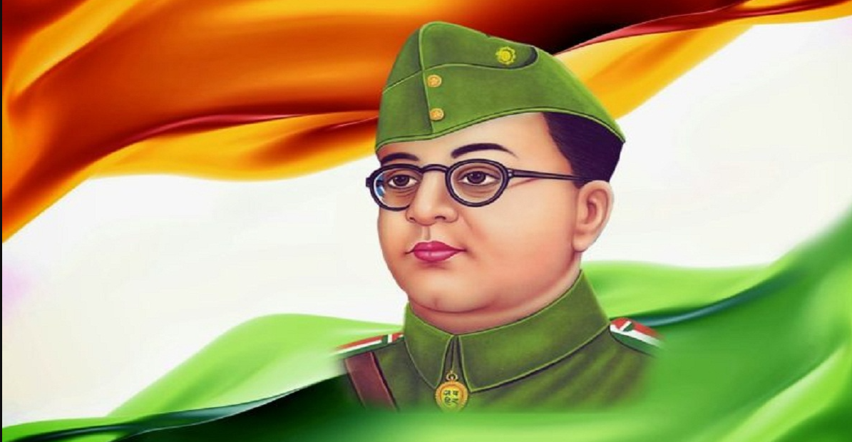
SUBHASH CHANDRA BOSE
1.EARLY LIFE
Subhash chandra bose was born on jan 23,1897 ,in cuttack ,orisa india into a bengali family
2.EDUCATION
He completed is school in from ravenshaw collegiate school in cuttack and later studied at presidency college at calcutta.
3.Civil Service
Bose cleared the Indian civil service examination in 1920 but resigned in 1921 due to his discontent with British rule in India
4.NETAJI
“NETAJI” by his supporters ,which means “RESPECTED LEADER “ in hindi

Slide 3
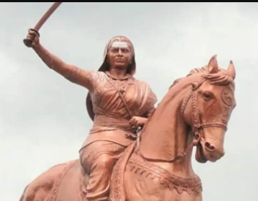
KITTUR RANI CHENNAMMA
BornChennamma
23 October 1778 Kakati, Belagavi District, present day Karnataka, India
Died21 February 1829 (aged 50) baihongal, Bombay, Company Raj NationalityIndianOther namesRani Chennamma, Kittur Rani ChennammaKnown for1857 Revolt against the British East India Company

